Slide 1
Page 0
First Letter of your last name: D
Your Full Name: Wyatt Duberstein
I promise I do not cheat on the exam. Your initial: WD
COM S 363: Exam 1
NOTES:
This is an open book open note exam.
You must work by yourself, without discussing with anyone else except TAs or instructors.
You can handwrite, but you are strongly encouraged to type/draw on these slides directly. Some shapes may be given for your convenience.
If more spaces are needed, you can create new slides.
Submit your file in PDF format.
Problem | Max Points | Points
1 | 40
2 | 30
3 | 30
Total | 100

Slide 2
Page 1
(40 points) You are asked to design a database for Story County Airport to store the following information.
Each airplane is identified by a registration number and must be of a specific model. There can be several airplanes belonging to the same model.
Each plane model is identified by a model number (e.g., DC-10) and has a capacity, weight, and the amount of full-tank gas. It is possible that airport may have no airplane from certain models.
All airport employees (including technicians and traffic controllers) belong to one union. Store the union membership number of each employee along with his/her name, address, phone number, and salary. Each employee is uniquely identified by a social security number. Each technician is an expert on at least one plane model. His or her expertise may overlap with that of other technicians. Technicians must not be traffic controllers and vice versa.
Traffic controllers must have an annual medical examination. For each traffic controller, only the date of the most recent annual exam is to be stored.
The airport has a number of tests that are used periodically to ensure that airplanes are still airworthy. Each test has a Federal Aviation Administration (FAA) test number, a name, and a maximum possible score.
The FAA requires the airport to keep track of each time a given airplane is tested by a given technician using a given test (i.e., who conducted which test for which plane). It is possible that a test was conducted by multiple technicians, an airplane went through multiple tests, and a technician tested different airplanes. For each testing event, the information needed is the date, the number of hours the technician spent doing the test, and the score the airplane received on the test.
Draw an ER diagram that captures all attributes of each entity set and each relationship set for the above requirements. Specify the key for each entity set and all the constraints for each relationship set. Specify any necessary overlap and covering constraints (in English). Use the ER notations introduced in our lectures.
Please draw your diagram in the next slide. The notations below are provided for your convenience. They are not meant to be complete, nor will you need all of them.
m
u
isa

Slide 3
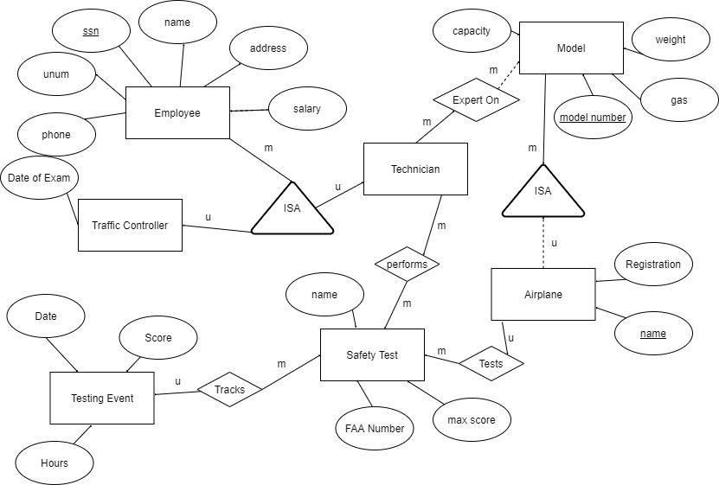
Page 2
Draw your ER diagram on this slide

Slide 4
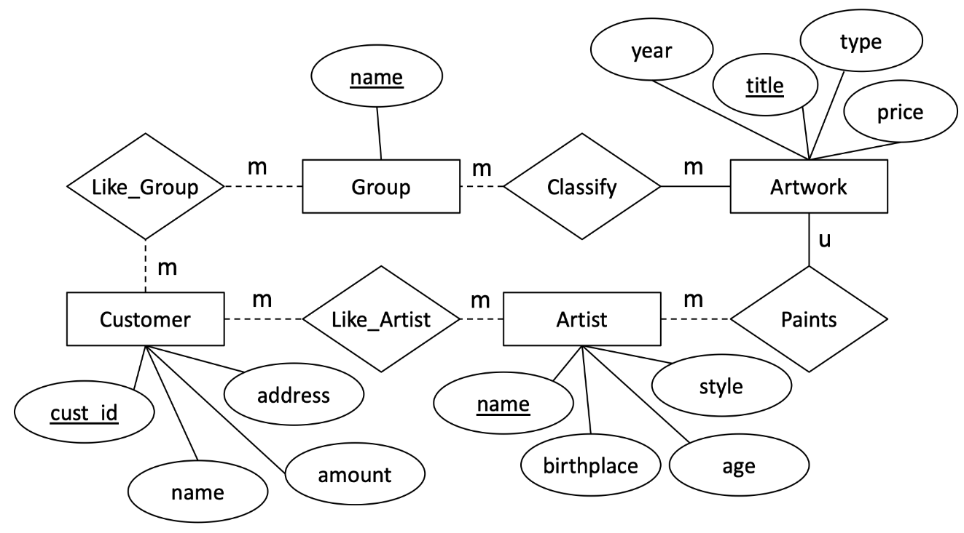
Page 3
(30 points) Convert the following E-R diagram into a set of relations. For each relation, use SQL's "create table" to specify its name, attributes, and constraints (i.e., key, primary key, and foreign key). You have the flexibility to specify types for the attributes, but you will lose points if your grader thinks it does not make sense (e.g., defining “title” as num).
Write your answers on the next slide.

Slide 5
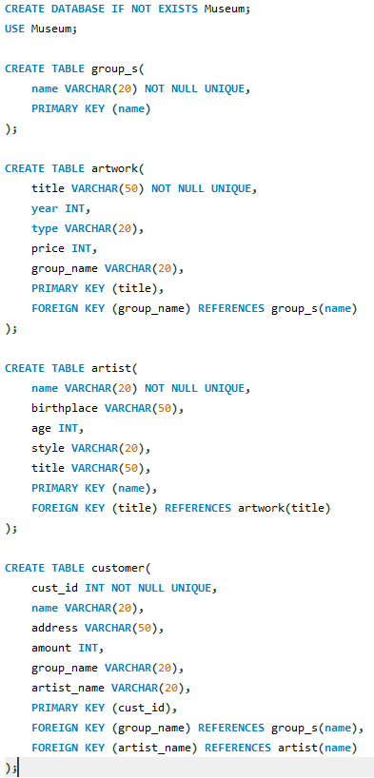
Page 4
Write your answers on this slide

Slide 6
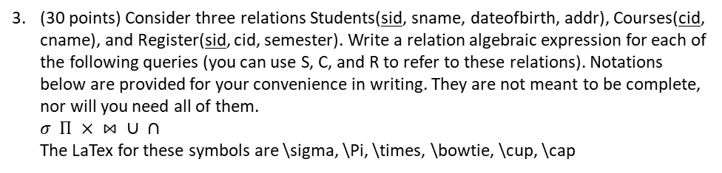
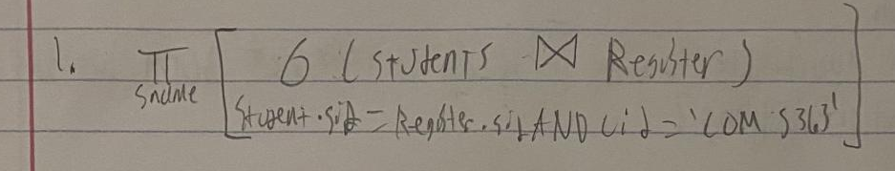
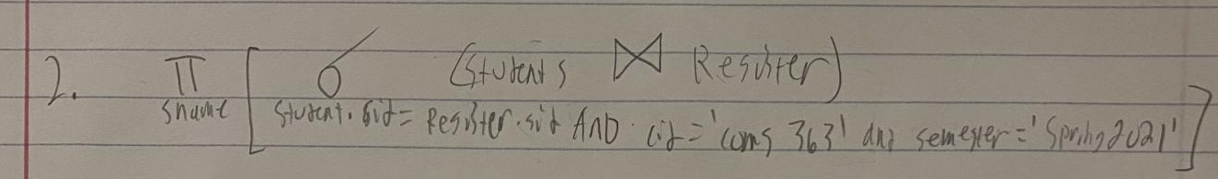
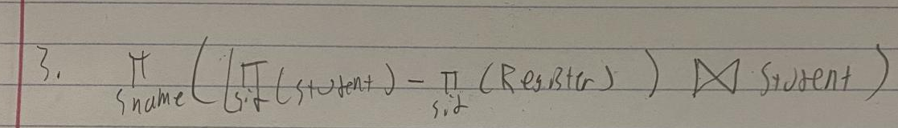
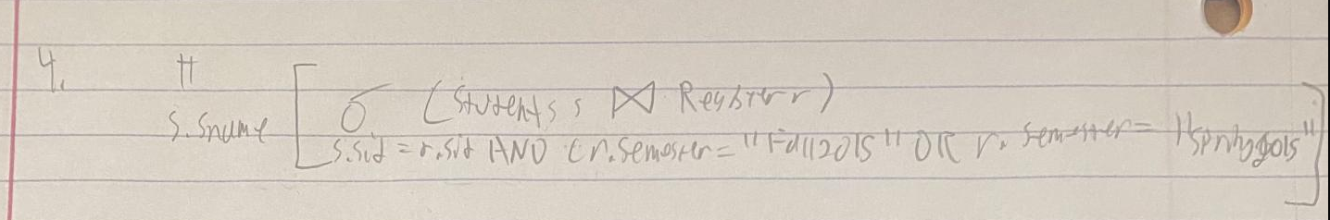
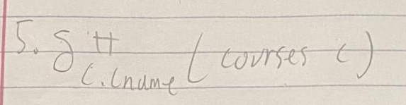
Page 5
(6 points) find the names of students who registered COMS363
2) (6 points) find the names of students who registered in COMS363 in Spring2021
3) (8 points) find the names of students who have not registered any course
4) (5 points)
select s.sname from students s, register r where s.sid = r.sid and (r.semester = "FALL2015" or r.semester="SPRING2015");
5) (5 points) select distinct c.cname from courses c;

Slide 7
Page 6
*(0 point) Opinion. This is voluntary. Highlight/make bold/underline your choice or type your comments.
I am confident / unconfident in my answers.
Most questions are expected / unexpected.
I think before the exam, I should have studied harder / I could have spent less time / I spent just the right amount of effort
I feel the course content so far is useful / somewhat useful / somewhat useless / useless

